Slide 1

Green Pace
Security Policy Presentation
Developer: Taylor Anderson

Slide 2

OVERVIEW: DEFENSE IN DEPTH
The policy that is most important is training. It is important to keep all employees aware of possible threats and follow other policies.

Slide 3
THREATS MATRIX
Having different threat levels help with prioritizing multiple threats and which need to be attacked first.
Likely Threats that will likely happen | Priority The order that threats are focused
Low priority Lower threats are focused last. | Unlikely Not likely to happen

Slide 4
10 PRINCIPLES
1. Validate Input Data
2. Heed Compiler Warnings
3. Architect and Design for Security Policies.
4. Keep it Simple
5. Default Deny
6. Adhere to the Principle of Least Privilege
7. Sanitize Data Sent to Other Systems
8. Practice Defense in Depth
9. Security Techniques
10. Coding standards being followed.

Slide 5
CODING STANDARDS
It checks to make sure that data coming from untrusted sources are safe.
Helps detect security warnings when modifying code and if it is unsafe and at what level it is
To enforce security policies that are designed by us.
Keeping code simple to avoid errors and security risks.
To deny access to users’ permits.
To keep unauthorized people from accessing data that has a higher security level.
It’s a complex subsystem that keeps hackers from injecting malicious code.
Keeping training up to date will help catch possible attacks. Following layers of security step by step will increase security.
testing phases, independent security reviews, and external security reviews can all lead to more secure systems.
To have a secure coding standard for development in whatever language and platform you are using

Slide 6
ENCRYPTION POLICIES
1. Encryption in rest- prevent the attacker from accessing unencrypted data by ensuring the data is encrypted when on disk.
2. Encryption at Flight-The process of encrypting data while the data is being transmitted. In some applications, such as remote replication, data may be unencrypted while it is at rest on drive arrays but encrypted while it is being transmitted to provide protection.
3. Encryption in - data in use enables access to encrypted data at rest and data in motion.

Slide 7
TRIPLE-A POLICIES
Authentication- a process where the user is identified by user login and password information for the user to be able to access parts of the system or use a 2-step authentication or multi-tier authentication.
Authorization - is the level of access that a user has within the system.
Accounting -is the process of monitoring what a user is and will keep track of what doing.

Slide 8
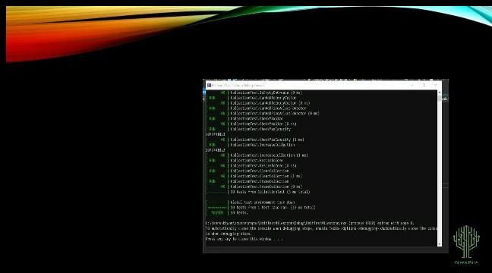
Unit Testing
Unit testing is to ensure that we have secure functioning code. It tests the code in smaller units which helps pinpoint issues faster.

Slide 9

AUTOMATION SUMMARY

Slide 10
TOOLS
[Explain the DevSecOps pipeline.]DevSecOps pipeline is an advanced security practice that scans threats and is intelligent.
Steps are to plan, build, test, release and deploy.

Slide 11
RISKS AND BENEFITS
The strategy is lacking the authentication process.

Slide 12
RECOMMENDATIONS
Gaps in the policies are threats being detected in time and how fast it is fixed.
Lack of monitoring.

Slide 13
CONCLUSIONS
Protecting Secrets and Data: Secure coding protects against secrets and business data from leaking into the public domain.

Slide 14
REFERENCES
[Provide APA-style references with links to resources, articles, and videos that you used in your presentation.]
https://www.youtube.com/watch?v=-Why_ZjJUhg
What Is Zero Trust Security?
: A Practical Guide to Zero-Trust Security

